Slide 1
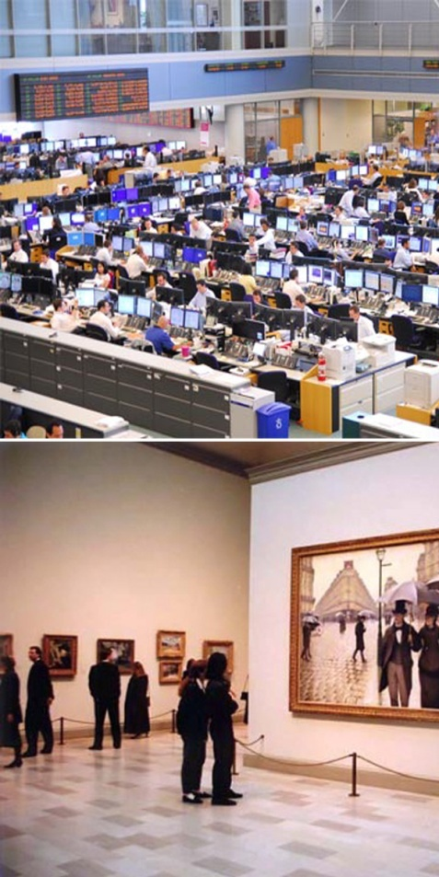
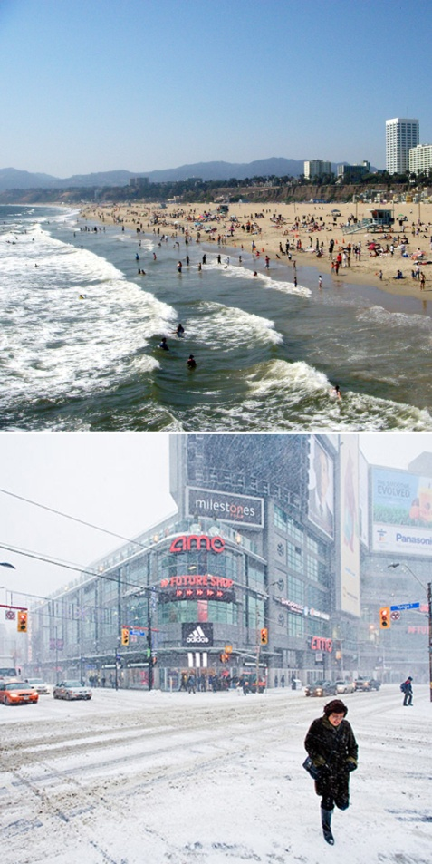
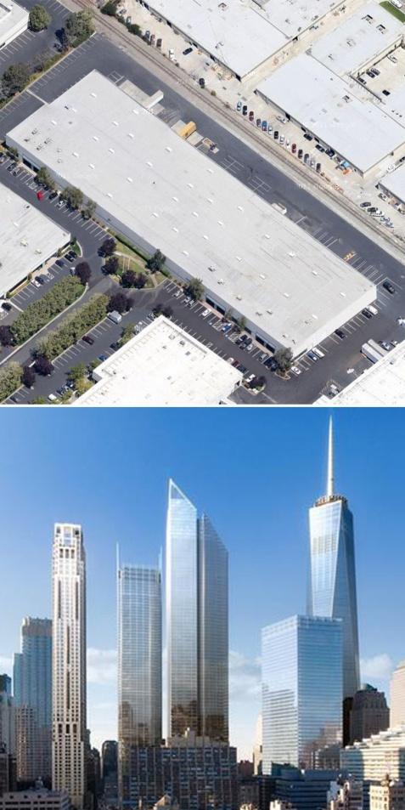

Greenroofs.com Virtual Summit 2011
E = MC² of Greenroofs
The amount of energy savings from a greenroof are determined by a combination of:
Mission Climate Construction

Slide 2
Greenroofs.com Virtual Summit 2011
E = MC² of Greenroofs
Ranking the Potential for Energy Benefits
    Mission
      Purpose : General Design
      Indoor heat generation : people, lights, equipment
      Schedules – When does the heat get generated?

Slide 3
Greenroofs.com Virtual Summit 2011
E = MC² of Greenroofs
Ranking the Potential for Energy Benefits
    Climate
      Where in the world :
      e.g. desert, temperate, coastal
      Where in the region :
      micro-climate
      Where in the neighborhood : nano-climate (shade, wind, etc.)

Slide 4
Greenroofs.com Virtual Summit 2011
E = MC² of Greenroofs
Ranking the Potential for Energy Benefits
    Construction
      Building size and shape : roof/wall ratio
      Interior :
      space dimensions,
      space under the roof
      Mechanical system design (ultimate energy impact)

Slide 5
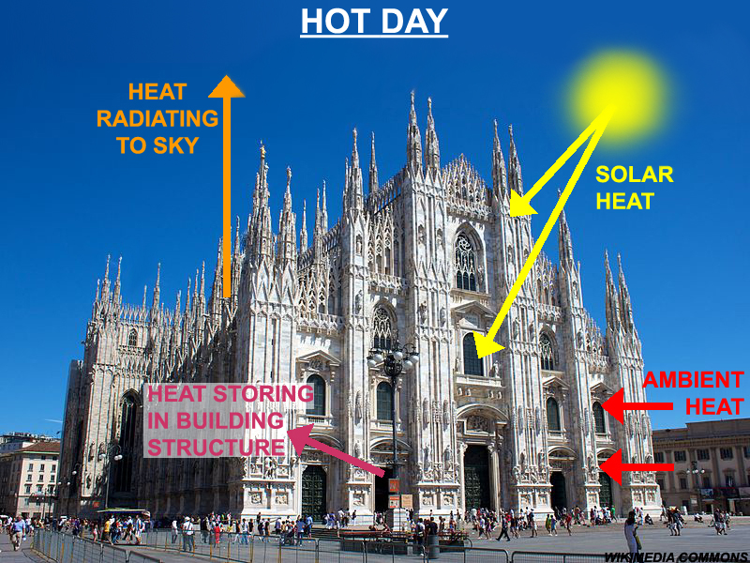
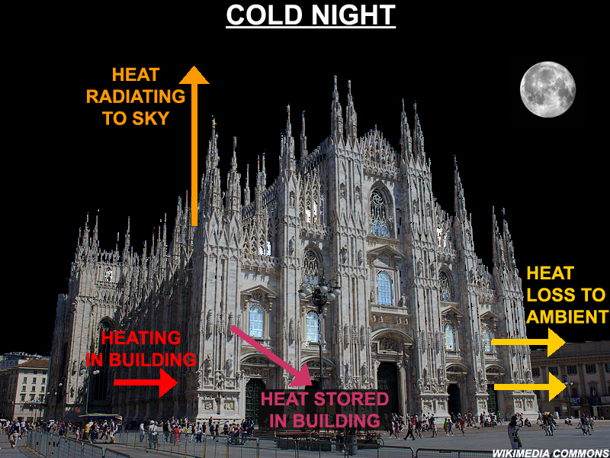
Greenroofs.com Virtual Summit 2011
E = MC² of Greenroofs
Energy Balance
    1st Law of Thermodynamics ( basic law of nature )
      Simple concept : Heat going in = Heat going out
      Complicated by changes with time ( aka “transients” )

Slide 6
Greenroofs.com Virtual Summit 2011
E = MC² of Greenroofs
Greenroof E = H+AC savings
Lights & misc. equipment
    Can make up a large % of total building energy use
    By themselves, cannot be affected by a greenroof
    Also create indoor heat (asset in winter, liability in summer)
    Ventilation
      Fan energy – can also be a large % of building energy
      Intimately tied to heating and air conditioning
    Heating and air conditioning
      The only part of building energy affected by the roof
      (unless you have sky lights)

Slide 7
Greenroofs.com Virtual Summit 2011
E = MC² of Greenroofs
Types of Savings
Absolute energy savings : kWh/yr , Btu/SqFt , etc.
      Highly dependent on building size and use
    % energy savings
      Of the whole building (operation & construction)
      Of just the A/C and heating energy
$ savings
    Energy : cost of electricity AND/OR gas, oil, etc.
    Capital costs : downgrade or eliminate HVAC equipment

Slide 8
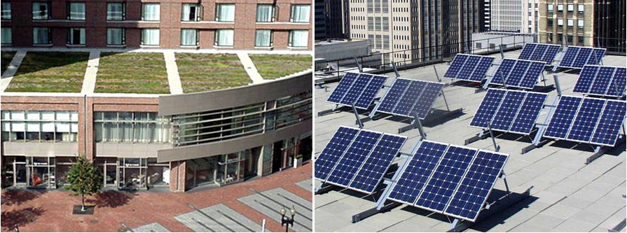
Greenroofs.com Virtual Summit 2011
E = MC² of Greenroofs
Greenroofs vs. Solar PV Panels
    Both deal with sunlight
      Daytime energy use
      Greenroofs are only preventive
Greenroofs are still active at night
    Roof surface (foliage) remains near outside temperatures
    Stored heat in the roof dissipates at the same rate

Slide 9
Greenroofs.com Virtual Summit 2011
E = MC² of Greenroofs
Greenroofs vs. Cool roofs
    Both deal with sunlight
      Cool roofs reflect most of it
      Greenroofs reflect, transfer, use all of it
Both are still active at night
    Cool roofs continue to emit heat at night – all year
    Greenroof foliage remains near outside temperatures
Seasons
    Cool roofs continue cooling all year
    Greenroofs adjust to seasonal changes

Slide 10
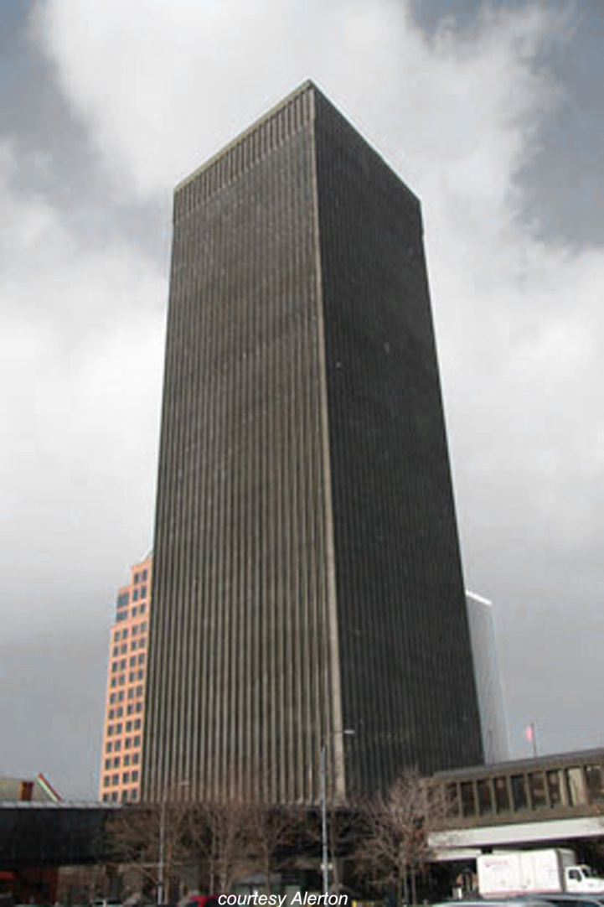
Greenroofs.com Virtual Summit 2011
E = MC² of Greenroofs
Worst Candidate for Energy Benefits
    Mission
      No temperature control
      Significant exhaust :
      labs, manufacturing
Climate
    Cold and cloudy, e.g. Rochester, NY
    Full-day shading
    Construction
      Skyscraper
      Bad mechanical design

Slide 11
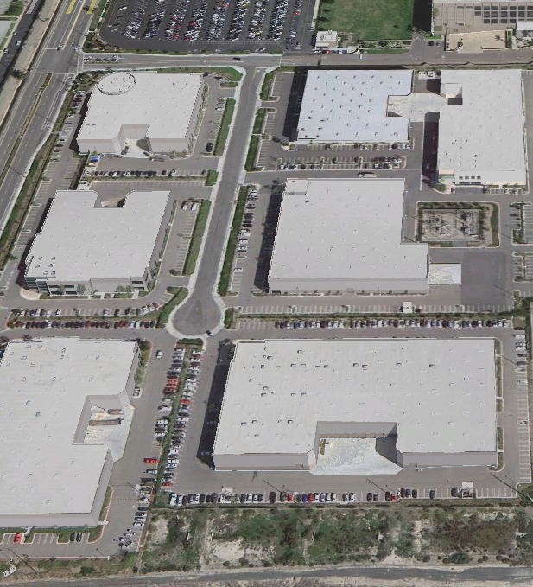
Greenroofs.com Virtual Summit 2011
E = MC² of Greenroofs
Best Candidate for Energy Benefits
    Mission
      Critical temperature control
      Little need for fresh air
Climate
    Warm and dry, e.g. Los Angeles
    No shading from trees or buildings
    Construction
      1 story
      Large footprint
      (large roof/wall ratio)

Slide 12
Greenroofs.com Virtual Summit 2011
E = MC² of Greenroofs
Correct answer: “It depends.”
    Every building is different
      Small differences in MC² can mean a big difference in E
      Specific features, schedules, or uses can be good or bad
Local codes may hurt possible savings
    R-value requirements
    Ventilation requirements
    Greenroof design details
      100% extensive coverage
      Partial intensive or roof patio design

Slide 13
Greenroofs.com Virtual Summit 2011
E = MC² of Greenroofs
Knowing the savings
    Energy modeling
      Must be done to get reasonable idea of savings
      DOE-2 (eQUEST, Energy Pro, Visual DOE, DOE-2.1e)
        Most widely recognized and accepted
        Problems: heavy walls/roofs, air flow, stratification ( + more! )
Realistic comparisons
    Comparing a greenroof to what other roof treatment?
    Real temperature settings
    Realistic features
Relying on marketing (“save as much as”) data is really bad

Slide 14
Greenroofs.com Virtual Summit 2011
E = MC² of Greenroofs
Comfort Benefits w/ Minimal Conditioning
Local climate potential
      Very mild climate
      Cool climate but considerable internal heat generation
Primarily with “Best Candidate” buildings
      Easier to control indoor environment
    More natural ventilation
      Open windows for cooling
      Use only exhaust fans for mixed mode ventilation

